Slide 1
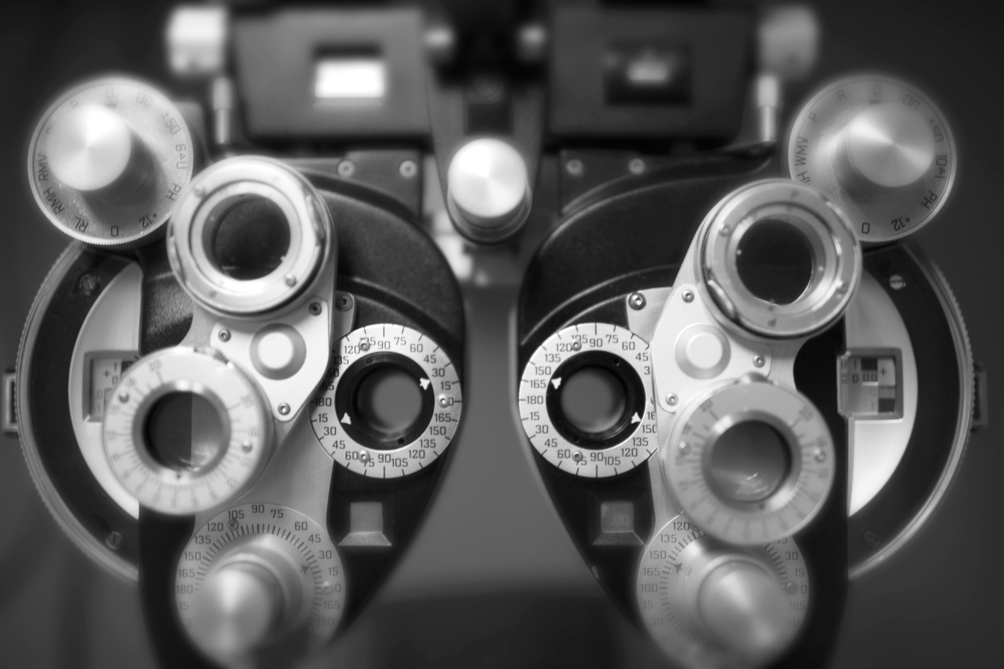
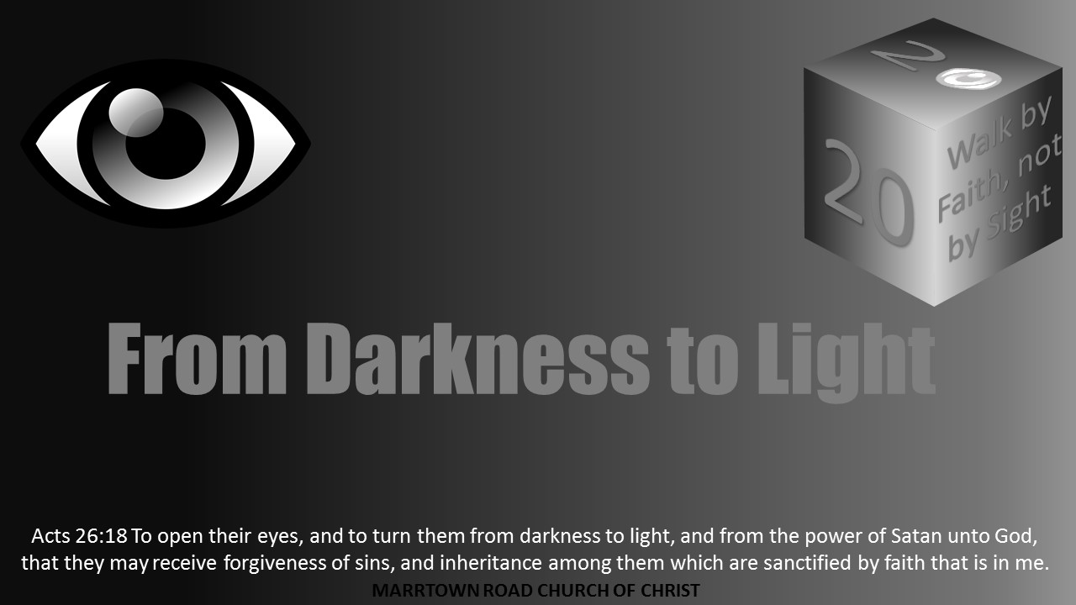

PROJECT
2
2

Slide 2
PROJECT
LESSON 9
2
2
BETWEEN TWO BLIND MEN:
Coming to Terms with Discipleship

Slide 3
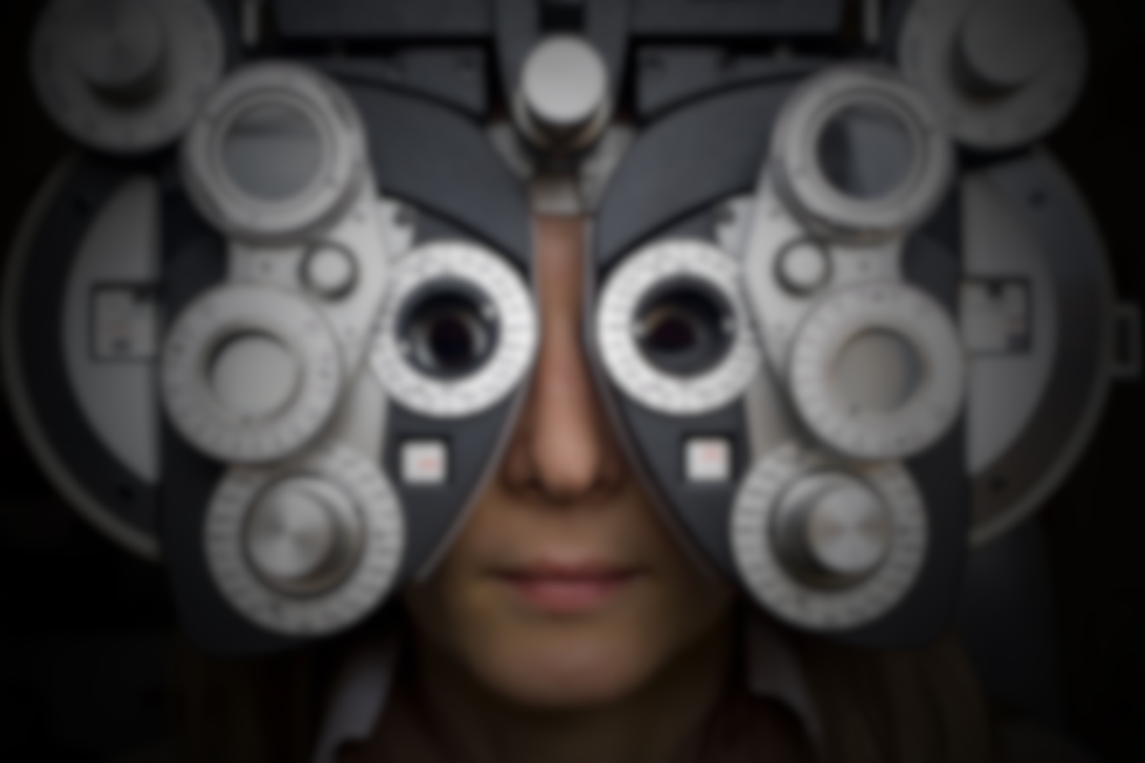
MARK 8:22-26
Why did it take Jesus two touches to heal the blind man?

Slide 4
MARK 8:22-26
Jesus’ healing technique teaches us that we need to look around and then look again.

Slide 5

BETWEEN TWO BLIND MEN
THE LEAD-UP: “Having eyes do you not see?” (Mark 8:18-21)
ADWEDGHOWZMDWPONDHSKELWPADHGQWZXMOPWEHMAPDHSLPEWMADKGHAODKMAPLKJSEDALKDJF
The blind man in Bethsaida: “Do you see?” (8:22-26)
Turning Point: “You are the Christ”
Journey to Jerusalem (8:27-10:45): The disciples don’t understand...
Main Point: “I came to serve”
Blind Bartimaeus in Jericho: “I want to see!” (10:46-52)

Slide 6
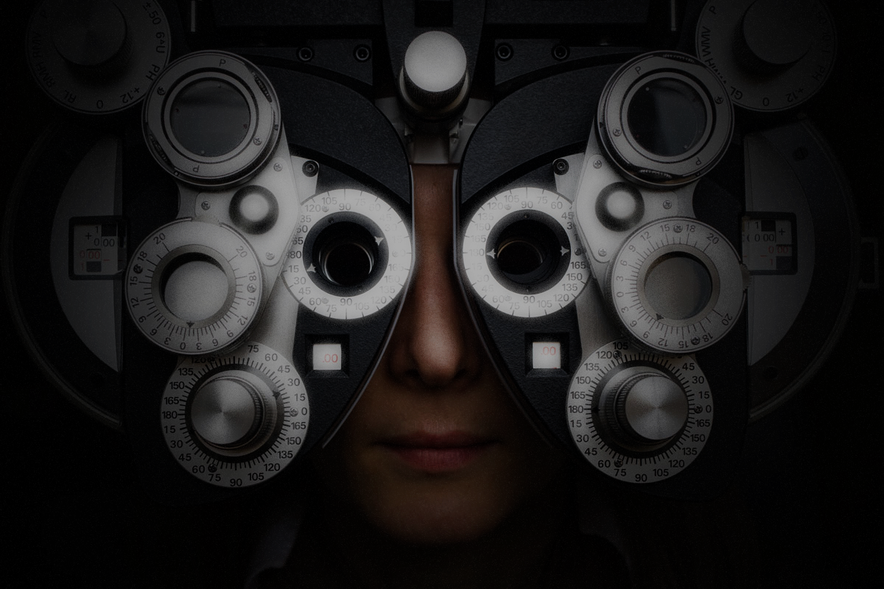
BLURRED VISION: HEALING BY STAGES
1
The apostles had gained no insight from Jesus’ feeding of the 5,000. Their hearts were hardened (Mark 6:52).
Jesus rebuked them for their lack of understanding about what causes sin (Mark 7:18).
They seem to have forgotten the prior feeding miracle (Mark 8:4)—or were they unable to imagine such a thing being offered to Gentiles?
A third voyage across the Sea of Galilee yields no better insight: “Having eyes do you not see …?” (Mark 8:18)
ADWEDGHOWZMDWPONDHSKELWPADHGQWZXMOPWEHMAPDHSLPEWMADKGHAODKMAPLKJSEDALKDJF

Slide 7
MARK 8:18-21
The healing of the blind man in Bethsaida is an illustration of the disciples’ own inability to see.

Slide 8
BLURRED VISION: HEALING BY STAGES
1
Jesus’ method—using saliva like a salve—was “speaking the Gentiles’ language.” It would have been understood as a healing act by the blind man and any observers.
Figuratively, the hands-on, two-stage miracle was for the sake of educating people with very little understanding. This includes the blind man … and the disciples!
ADWEDGHOWZMDWPONDHSKELWPADHGQWZXMOPWEHMAPDHSLPEWMADKGHAODKMAPLKJSEDALKDJF

Slide 9
MARK 8:27-30
Jesus administers a vision test: “Who do people say that I am?” Peter passes the test. His answer is the turning point of this gospel.

Slide 10
GETTING A CLEARER VIEW: THE PATH OF DISCIPLESHIP
2
ADWEDGHOWZMDWPONDHSKELWPADHGQWZXMOPWEHMAPDHSLPEWMADKGHAODKMAPLKJSEDALKDJF
The blind man in Bethsaida: “Do you see?” (8:22-26)
Turning Point: “You are the Christ” (8:29)
Journey to Jerusalem (8:27-10:45): The disciples don’t understand (a three-step process in three cycles):
Passion prediction
Misunderstanding
Teaching about discipleship
Main Point: “I came to serve” (10:45)
Blind Bartimaeus in Jericho: “I want to see!” (10:46-52)

Slide 11
MARK 10:46-52
It is amazing how much this blind man sees before his vision is miraculously given to him!

Slide 12
VISION BEFORE HEALING: A READY-MADE DISCIPLE
3
Bartimaeus calls Jesus “Son of David,” a messianic title.
In tossing aside his cloak, he is showing he is “casting off” his old life and preparing to take action.
“Rabboni” means “my master” or “my teacher.”
Jesus heals him without a touch or even word of command.
As “immediately” as he was healed, he followed.
ADWEDGHOWZMDWPONDHSKELWPADHGQWZXMOPWEHMAPDHSLPEWMADKGHAODKMAPLKJSEDALKDJF

Slide 13

Compare the two miracle stories, Mark 8:22-26 and 10:46-52.
How do the miracles play out?
What are the end results?

Slide 14
In what ways does the Gospel “meet us where we are”?

Slide 15
Why do you think the apostles had such a hard time understanding what Jesus was trying to tell them? What is the application to us?

Slide 16
Is there some truth or life lesson that took a long time and repeated applications for you to finally see? Provide an example.

Slide 17
Was your own conversion more like the healing of the blind man in Bethsaida or like the healing of Bartimaeus? Why do you think so?

Slide 18
(a) What are some things as a younger disciple you did not see? How did this become clearer in time?

Slide 19
(b) How do these two healing stories help us understand that discipleship is a process of diligently looking and looking again as the Lord patiently works to bring us to wholeness?

